Slide 1
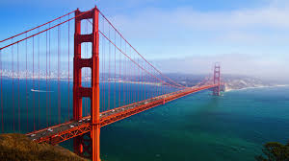
San Francisco
Mallorey Blake, Jaclyn Bates, Danielle Reagan

Slide 2
Prehistory
3,000 BC: The first inhabitants of San Francisco are discovered
16th century: Yelamu tribe lives here
1769: Westerners part of the Portola expedition stumble upon the San Francisco bay
1786: Juan Bautiza de Anza leaves San Diego to start a Spanish settlement in San Francisco
1808: Mission San Francisco de Asis is the center of spiritual life for local tribes

Slide 3
Leading to the American Takeover
1821: Mexico wins independence from Spain, which leads to the downfall of the mission in San Francisco
1835: American William Richardson becomes the first settler of Yerba Buena (original name of San Francisco)
1840s: Americans come to the upper part of California where San Francisco is to fight for their independence
1847: Yerba Buena is renamed to San Francisco
1946: US Navy sailor James B. Montgomery comes ashore Yerba Buena (today Portsmouth Square) and raises the American flag

Slide 4
Gold Rush Causes Rapid Growth in Population
1848: First gold found in the California Foothills at Sutter’s Fort
1849: Population increases by 24,000 people because San Francisco is the central port and depot of the Gold Rush
“forty-niners” cause the huge increase
1849-1851: Residents of the city go wild causing an increase in prostitution and gambling
The craziness leads to 6 major fires erupting
1859: Population increases again because of Nevada’s Comstock Lode filling the city’s dock. Also, construction for the Central Pacific Railroad begins which draws thousands of workers from all over the world – especially China.
The increase in Chinese residents creates a thriving Chinatown and the second (only to Asia) largest Chinese settle
1887: 1,000 acres on the Pacific side of the peninsula are carved out to create the Golden Gate Park. And cable cars become prominent.

Slide 5
Downfall
1906: An earthquake measured at 7.8 on the Richter scale erupts due to the slipping of the San Adreas Fault
The tremors broke water mains which caused fires that raged for 4 days straight and killed thousands of people, destroying thousands of buildings, and leaving hundreds of thousands of people homeless
1915: San Francisco is able to host the Panama International Exposition because over the course of those 9 years, the residents did nothing but rebuild and improve their city
1930s: The Golden Gate Bridge and San Francisco Bay Bridge are constructed, which leads to population growth

Slide 6
Aiding in Wars
San Francisco became one of the biggest arms production center during World War II
The war caused an increase in African American residents because the Japanese populated many of the neighborhoods but when they were forced into internment camps, African Americans moved into their neighborhoods
San Francisco played a role in the Cold War because this is where the UN Charter was drafted in 1945

Slide 7
History of Alcatraz
It is considered “the
prison of American prisons”
1775: Juan Manuel de Ayala chartered La Isla de los Alcatraces (San Francisco Bay)
It is 22 acres of desolation – no vegetation or habitation
English speakers began to call it Alcatraz

Slide 8
Fort Alcatraz
1850: It is reserved for military use under President Millard Fillmore
1859: It is deemed “Fort Alcatraz” after a fortress was built around the land with 100 cannons installed making it the most heavily armed entity on the West Coast
It never actually fired any of its weapons because it didn’t need to, so it turned into an island of detention rather than its original purpose as an island of defense
1860s: People that were arrested for treason during the Civil War were are sent here
It was designed to hold up to 500 men, but during its existence as a detention center it only reached up to 300 never filling its full capacity

Slide 9
“The Rock”
1906: A huge earthquake devastates San Francisco and causes all inmates of surrounding prisons to be sent to Alcatraz
It earns the nickname “The Rock”
It serves as an army disciplinary barracks until 1933
Prisoners receive military training, education and vocational training
20th century: It is a minimum security prison and allows prisoners to work outside doing things like gardening and even babysitting for some of the officers.
A baseball field is built so that prisoners can have fun on their free time. They also have boxing matches for fun, which became known as “Alcatraz Fights”

Slide 10
Federal Penitentiary
Alcatraz becomes known as “Uncle Sam’s Devil’s Island”
1934: It becomes America’s first maximum security prison for civilians
It was specifically designed for the worst criminals that other prisons would not be able to handle. The dangerous terrain and water surrounding the area made it an ideal place to house these horrible criminals because it would be impossible to escape without dying.
Over 29 years, the prison housed over 1,500 prisoners
The only rights given to prisoners were food, shelter, clothing, and medical attention
Punishments included hard labor, solitary confinement with only bread and water, and having a 15 pound ball chained to the leg
There were 14 escape attempts but no one was ever reported as succeeding

Slide 11
Closing Alcatraz
1963: Alcatraz is closed because of the great expense of shipping supplies like food and fresh water over by boat
1972: It becomes a national park that is part of the Golden Gate National Recreation Area
1973: It opens to the public with more than one million tourists each year

Slide 12
Facts about San Francisco
Population- 805, 340
Neighborhoods- 146
Males- 50.7%
Females- 49.3%
Median Resident Age- 38.5
Estimated Median Household Income- $70,770
Estimated Median House or Condo value- $751, 600
Median Gross Rent- $1,363
Ancestries: Irish (8.9%), German (7.7%), English (6.1%), Italian (5.0%), Russian (2.8%), French (2.3%)
City-Data.com

Slide 13
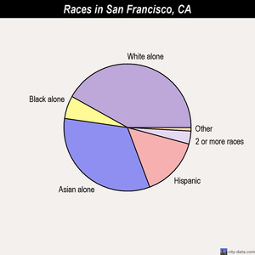
Races in San Francisco
White alone - 337,451 (41.9%)
Asian alone - 265,700 (33.0%)Hispanic - 121,774 (15.1%)
Black alone - 46,781 (5.8%)
Two or more races - 26,079 (3.2%)
Native Hawaiian and Other Pacific Islander alone - 3,128 (0.4%)
Other race alone - 2,494 (0.3%)
American Indian alone - 1,828 (0.2%)
City-Data.com

Slide 14
Crime Rates
Annual Crimes
5,465 violent; 33,779 property; total = 39,244
Annual Crimes per 1,000 residents
6.72 violent; 41.56 property; total = 48.28
Safer than 10% of cities in the US
Violent Crimes
50 murders; 134 rapes; 3,142 robberies; 2,139 assaults
Property Crimes
2,188,005 burglaries; 6,159,795 thefts; 715,373 motor vehicle thefts

Slide 15
Crime Rates
There is a 1 in 21 chance of becoming a victim in a violent crime
It has a 94% crime rate in comparison to other California cities.
Based on other cities of similar size, San Fran's crime rate is lower than the average, so it is safer.

Slide 16
10 Safest Neighborhoods
1. Bayshore Blvd/Bacon St
2. Lincoln Way/South Dr
3. Oretaga St/19th Ave
4. Richmond District
5. Lake St/El Camino Dr
6. 16th St/Harrison St
7. San Francisco State U/ 19th Ave
8. Clement St/Legion of Honor Dr
9. Vincente St/Portola Dr
10. Noriega St/ 22nd Ave

Slide 17
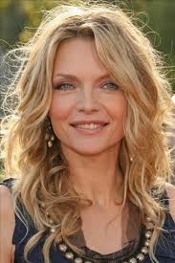
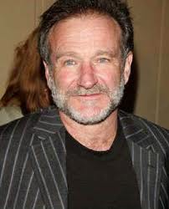
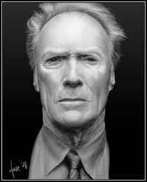
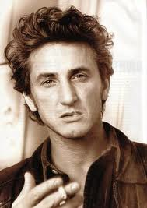
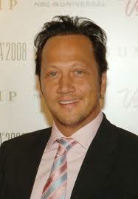
Celebrities in the Area!
Robin Williams (actor)
Sean Penn (actor)
Danielle Steele (author)
Danny Glover (actor)
Sharon Stone (actress)
Nicholas Cage (actor)
Rob Schneider (comedian)
Clint Eastwood (actor)
Michelle Pfeiffer (actress)
Source: http://answers.yahoo.com/question/index?qid=20060819111831AAXBQ1W

Slide 18
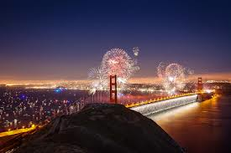
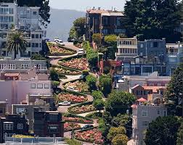
Culture
Diverse in terms of art, music, cuisine, festivities, museums, and architecture!
Attracts a diverse amount of people from all over the world!

Slide 19
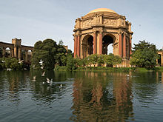
Museums
San Francisco Museum of Modern Art (SFMOMA)
20th Century to contemporary pieces
The Palace of Fine Arts
Museum of popular science
Asian Art Museum of San Francisco
San Francisco Zoo
Cares of over 250 species!
The Palace of Fine Arts

Slide 20
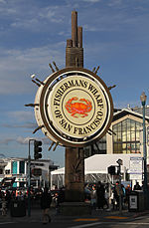
More Museums!
Contemporary Jewish Museum
Museum of African Diaspora
Cartoon Art Museum
Ripley’s Believe It Or Not! Museum
The Tattoo Art Museum
The Wax Museum
The UFO, Bigfoot, and Loch Ness Monster Museum
Many of these museums are located
at Fisherman’s Wharf, a popular neighborhood in San Francisco
With all of these different types of cultural museums, San Francisco proves to be an incredibly diverse place!

Slide 21
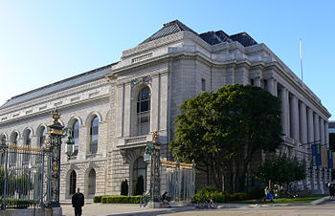
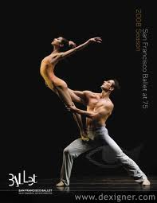
Performing Arts
Popular Classical and Opera venues include the San Francisco Symphony, The San Francisco Opera House, and The San Francisco Ballet
All of these are performed at The San Francisco War Memorial and Performing Arts Center, which are some of the oldest performing arts companies in America.

Slide 22
Music
Tony Bennett’s “I Left My Heart in San Francisco
http://www.youtube.com/watch?v=I6d03gbmAzc
Train’s “Save Me, San Francisco”
http://www.youtube.com/watch?v=zftcZYdOl3Y
This music video is filmed in various different places in San Francisco; it is very cool to see!

Slide 23
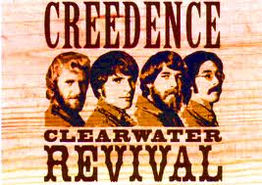
More Music!
San Francisco was the birth of many trends in rock music in the 1960s.
The two most influential bands of the era were the Grateful Dead and Jefferson Airplane
More bands include Journey, Creedence Clearwater Revival, Metallica, and Santana

Slide 24
Parades and Festivals
San Francisco is the home of many unique and famous street parties, parades, and festivities!
Some of these include…
San Francisco Lesbians, Gay, Bisexual, and Transgender (LGBT) Parade
The Chinese New Year Parade
Folsom Street Fair
Running marathons Bay to Breakers and the San Francisco Marathon

Slide 25
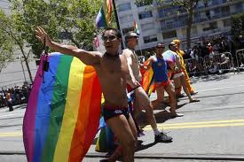
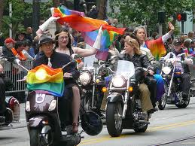
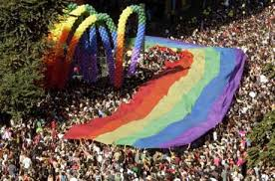
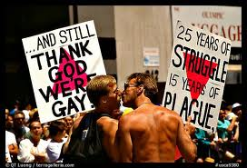
LGBT Parade

Slide 26
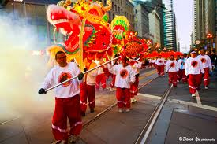
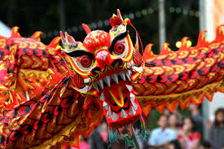
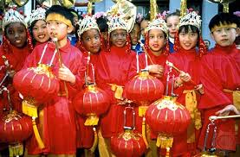
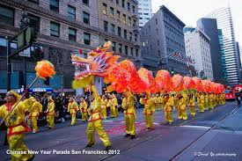
Chinese New Year Parade

Slide 27
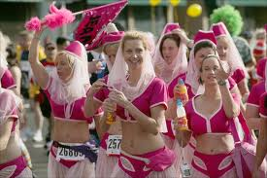
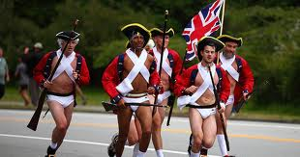
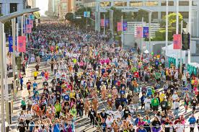
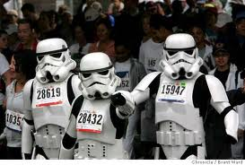
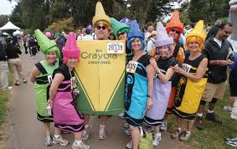
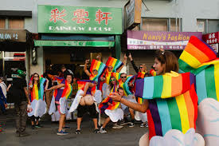
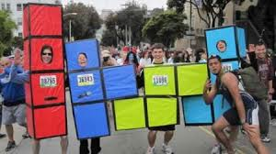
Bay to Breakers Marathon

Slide 28
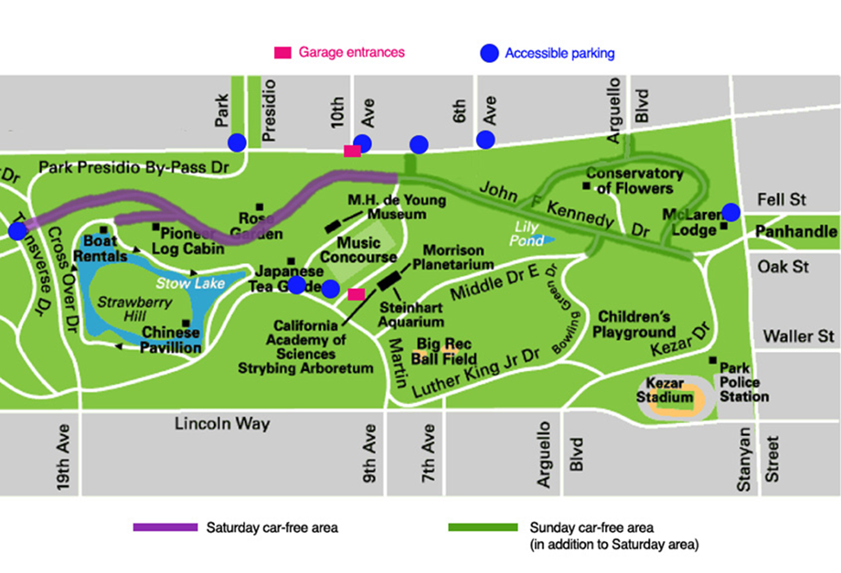
Golden Gate Park
“Generalized parks can and do add great attraction to neighborhoods that people find attractive for a great variety of other uses” -Jane Jacobs
Golden Gate Park is a blend of gardens, museum culture, and recreational places.

Slide 29
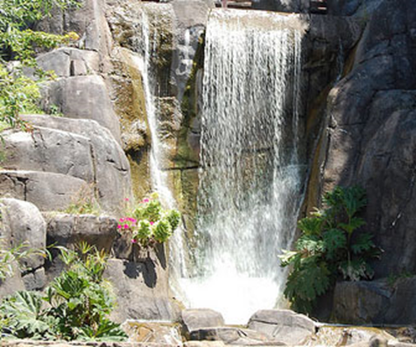
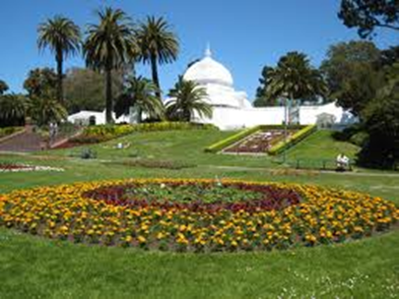
Golden Gate Park Parks need to have “real uses” not “mythological uses” -Jane Jacobs (91)
Uses of Golden Gate Park:
San Francisco Botanical Garden Society
Golden Date Mother’s Playground
Conservatory of Flowers
Koret Children’s playground
Baseball field
Kezar Stadium
Tenis Complex
Horseshoe Pits
Little Rec Soccer fields
Stow Lake, as well as many other lakes
Golden Gate Park Golf Course
Golden Gate Polo Field
San Francisco Bicycle Route
Equestrian Center
Have a calendar of events for every month: http://www.golden-gate-park.com/category/events

Slide 30
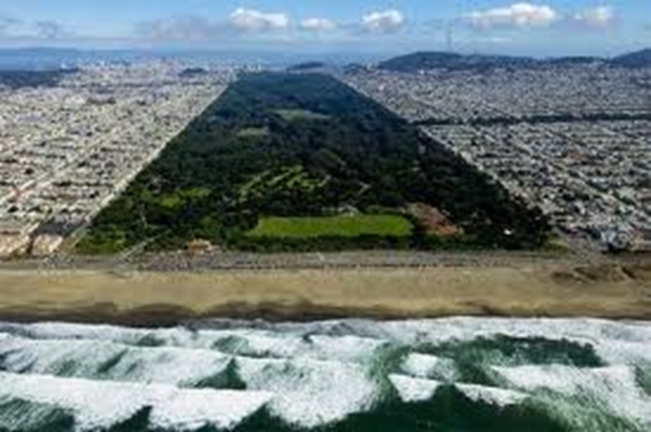
Golden Gate Park
“The more successfully a city mingles everyday diversity of uses and users in its everyday streets, the more successfully, casually (and economically) its people thereby enliven and support well-located parks that can thus give back grace and delight to their neighborhoods instead of vacuity” - Jane Jacobs (111)
Surrounding Golden Gate Park:
Rectangular like park with three sides open to residential houses and small businesses (Fulton St, Lincoln Way, and Stanyan St)
In these surrounding neighborhoods of the park there are elementary schools, playgrounds, high schools and churches
The final side of the park opens to the beach

Slide 31
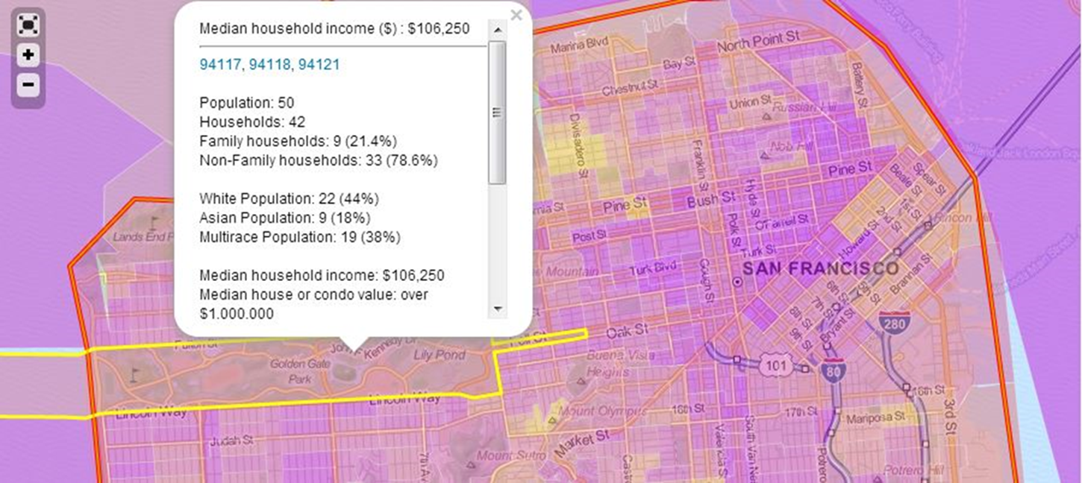
Golden Gate Park
Golden Gate Park as a Neighborhood

Slide 32
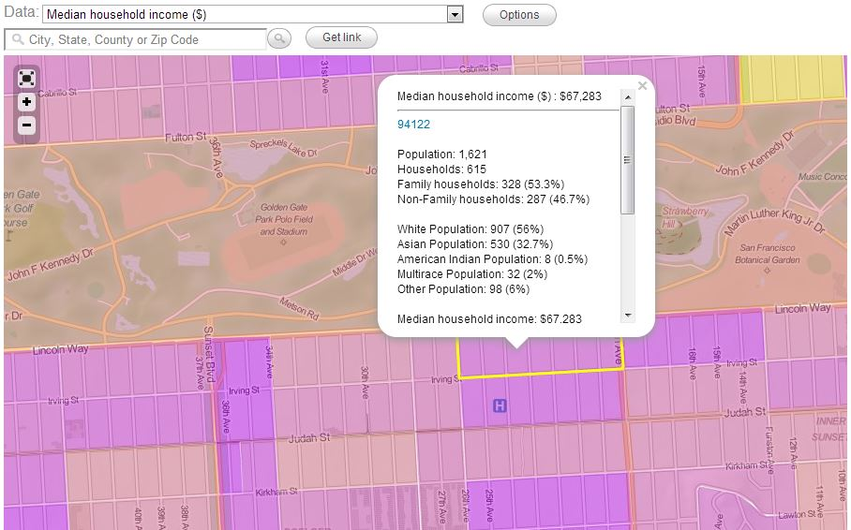
Golden Gate Park
Surrounding neighborhoods

Slide 33
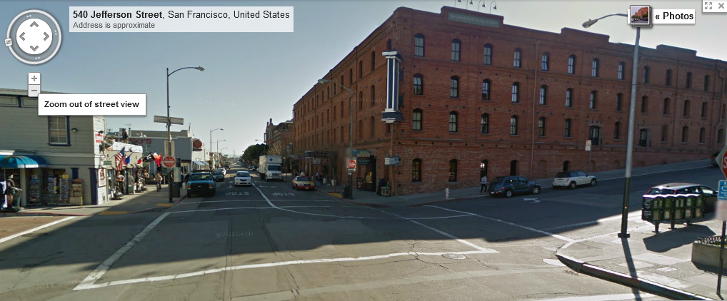
Generator of Diversity
“The district must mingle buildings that vary in age and condition, including a good proportion of old ones” -Jane Jacobs Picture Bellow: old building on historic Fisherman’s Warf

Slide 34
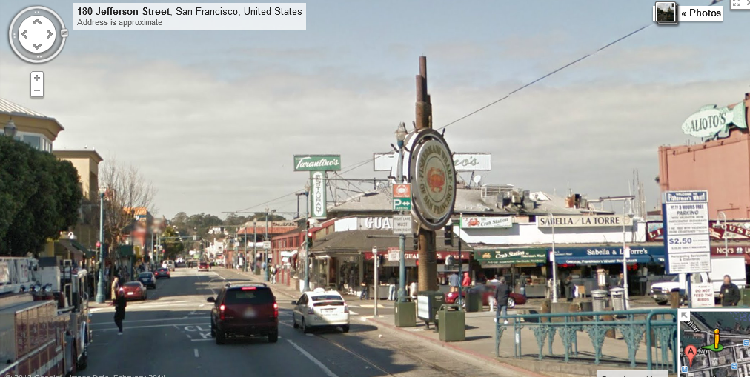
Generator of Diversity
Fisherman’s Warf, a waterfront community founded in 1946, offers diverse foods and culture.

Slide 35
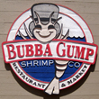
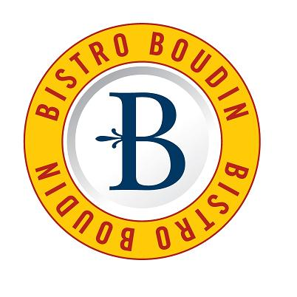
Generator of Diversity
Different Restaurants located on Fisherman’s Warf:
Alioto’s family owned seafood restaurant
Annie’s Hot Dogs and Pretzels (since 1983)
Bistro Boudin
Bubba Gump Shrimp
Japanese Grill and Sushi Bar
King of Thai Noodle House
Along with many more!

Slide 36
Slums and Un-Slumming
“Slums and their populations are the victims (and the perpetrators) of seemingly endless troubles that reinforce each other. Slums operate as vicious circles” -Jane Jacobs (270)
The Huffington Post recorded, “A recent study by the Federal Reserve Bank of San Francisco found that, over the past decade, poverty in the Bay Area has shifted out of the cities and into the suburbs. From 2005 to 2009, the percentage of people living in poverty in the suburbs grew by 16 percent, compared with a 7 percent increase in urban areas.”

Slide 37
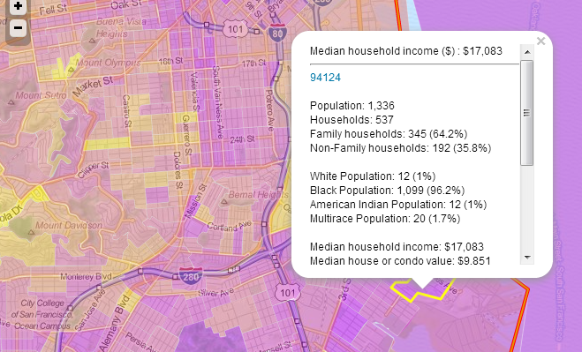
Slums and Un-Slumming
Some of Jacobs’ reasons for the vicious circle of slums are: require great amounts of money people move out too fast—hinging upon people living in these area wanting to make a difference in this area or wanting to move out
This neighborhood near the Bay View Area shows a median household income of $17,083.

Slide 38
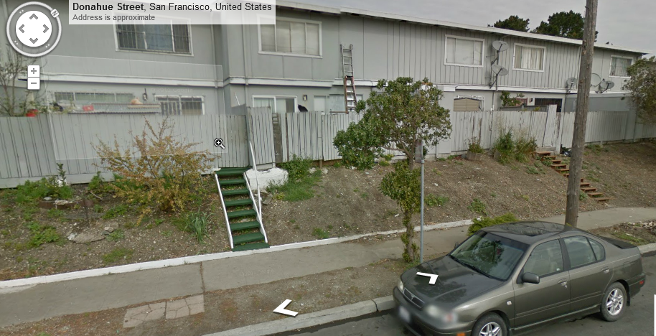
Slums and Un-Slumming
Hunter’s Point: an Area of San Francisco becoming “un-slummed” picture bellow shows before completed renovations

Slide 39
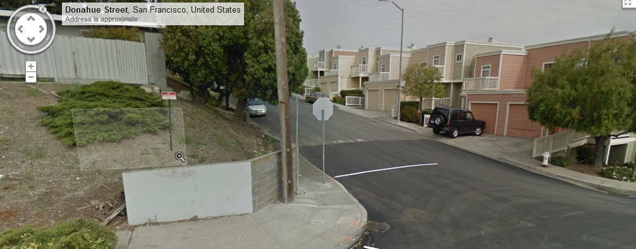
Slums and Un-slumming
Hunter’s Point: an Area of San Francisco becoming “un-slummed” Picture bellow: shows the new renovations at the end of the street

Slide 40
Sources
http://www.sanfrancisco.com/history/
http://www.sfhistory.org/
http://www.history.com/topics/san-francisco (good videos on this site!)
http://geography.about.com/od/unitedstatesofamerica/a/Alcatraz-Prison-Facts.htm
http://www.neighborhoodscout.com/ca/san-francisco/crime/

Slide 41
More Sources!
"Fisherman's Wharf - San Francisco's Historical Fishing District." Fisherman's Wharf - San Francisco's Historical Fishing District. N.p., n.d. Web. 07 May 2013. <http://www.fishermanswharf.org/>.
"Golden Gate Park." Golden Gate Park. N.p., n.d. Web. 07 May 2013. <http://www.golden-gate-park.com/>.
Jacobs, Jane. The Death and Life of Great American Cities. New York: Vintage, 1992. Print.
Sankin, Aaron. "Bay Area Poverty: Poor Pushed From San Francisco To Suburbs." The Huffington Post. TheHuffingtonPost.com, 05 Sept. 2012. Web. 07 May 2013. <http://www.huffingtonpost.com/2012/09/05/bay-area-poverty_n_1855189.html>.

